Slide 1
Consumer Debit Top of Wallet Strategy Report
Visa Consulting & Analytics
Data through
Q1-2024

Slide 2
Notice of confidentiality
This presentation is furnished to you solely in your capacity as a customer of Visa Inc. and/or a participant in the Visa payments system. By accepting this presentation, you acknowledge that the information contained herein (the “Information”) is confidential and subject to the confidentiality restrictions contained in Visa’s operating regulations and/or other confidentiality agreements, which limit your use of the Information. You agree to keep the Information confidential and not to use the Information for any purpose other than in your capacity as a customer of Visa Inc. or as a participant in the Visa payments system. The Information may only be disseminated within your organization on a need-to-know basis to enable your participation in the Visa payments system. Please be advised that the Information may constitute material non public information under U.S. federal securities laws and that purchasing or selling securities of Visa Inc. while being aware of material non public information would constitute a violation of applicable U.S. federal securities laws.

Slide 3
Exec summary & Recommendations

Slide 4





Executive Summary
Issuers seek to achieve higher engagement and drive top of wallet status within their consumer portfolios. To help you achieve this, VCA has produced this customized report to:
Identify cardholders who are top-of-wallet
Develop a go-to-market strategy to improve cardholder engagement
Size the revenue opportunity of improving engagement
Project Overview
VCA leveraged a proprietary scoring model to understand Top-of-Wallet behavior
The Top of Wallet (TOW) model identified ~ TOW accounts that could generate (~ ) in annual payment volume. Your top-of-wallet cardholders have an annual spend of ~ on average vs. non-top of wallet cardholders where the average is annually. Due to the interchange opportunities, top-of-wallet cardholders represent a population that should be prioritized for retention.
Based on the analysis, you have an opportunity to capture an additional in debit interchange revenue by driving top of wallet spend and penetration, relative to peers.
675K
$324M
12%
$6712
$4523
Findings
$453K
VCA has developed recommendations around these three themes, with a focus on improving customer engagement:
“Defend”
“Grow”
“Acquire”
Defend payment volume from existing top of wallet cardholders
Convert existing average spenders to top of wallet
Encourage top of wallet behavior in new accounts
Recommendations

Slide 5
Revenue can be increased by boosting TOW penetration & TOW spend, while reducing TOW attrition
DIRECTIONAL
 | Consumer Debit
Annual Interchange
Opportunity Sizing
1. Increase TOW Penetration Convert Non-Top-of-Wallet accounts to Top-of-Wallet status
Total Annual Opportunity
$56M
$1233K
$56K

Slide 6
Analysis

Slide 7


Payment volume growth was similar relative to peers
TOW Penetration
TOW vs. Non-TOW Spend
Top-of-wallet penetration declined and lagged peers
Your top-of-wallet cardholders spend, on average, more per year than peers
$264
$272
Source: VisaNet, Q1 2024 - Q2 2024

Slide 8
Millennial and Gen-Z spend is similar to peers for top-of-wallet cardholders
Spend per active account for Millennials
Using our proprietary behavioral model, we can identify likely Millennial/Gen-Z cardholders; younger cardholders are a key growth segment in both the short- and long-term
Source: VisaNet, Q1 2024 - Q2 2024

Slide 9
Payment volume growth was similar relative to peers
Spend grew
12.5%
Previous Year
Newly Acquired
Organic Growth
Silently Attired
Recent Year
Source: VisaNet, Q1 2024 - Q2 2024

Slide 10
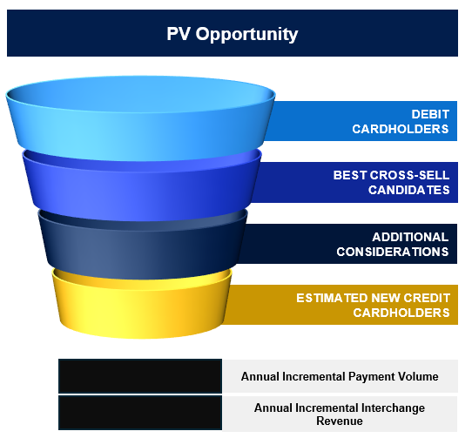
Client has an opportunity to gain up to $10.3M in incremental payment volume by running a well-targeted campaign
START WITH THOSE LIKELY TO ACT
As an illustrative example, the top 3 deciles contain 11.9K cardholders who are most likely to open a card.
32.8K
BUILD ON TOP OF DXP SCORING
We encourage Client to layer in other factors in arriving at your target audience. DXP does not consider underwriting nor recency of the previous contract, etc.
23.7K
4.3K
231-320
RUN A HIGH YIELD CAMPAIGN
There are many subjective factors that will drive the ultimate outcome. Assuming 2.5%-5.0% response rate of a campaign, we could expect 149-477 new credit cardholders from the existing debit portfolio.
$3.2M-$10.3M
$42K - $134K
Source: VisaNet, Q1 2024 - Q2 2024

Slide 11
Millennial and Gen-Z spend is similar to peers for top-of-wallet cardholders
Spend per active account for Millennials
Using our proprietary behavioral model, we can identify likely Millennial/Gen-Z cardholders; younger cardholders are a key growth segment in both the short- and long-term
Declined Cards
345K
Source: VisaNet, Q1 2023 – Q1 2024

Slide 12
Payment volume growth was similar relative to peers
CNP | ToW | TECHNOLOGY CREDIT UNION PEERSET VISANET
 | Non ToW | TECHNOLOGY CREDIT UNION PEERSET VISANET
CP | ToW | TECHNOLOGY CREDIT UNION PEERSET VISANET
 | Non ToW | TECHNOLOGY CREDIT UNION PEERSET VISANET
Source: VisaNet, Q1 2024 - Q2 2024

Slide 13
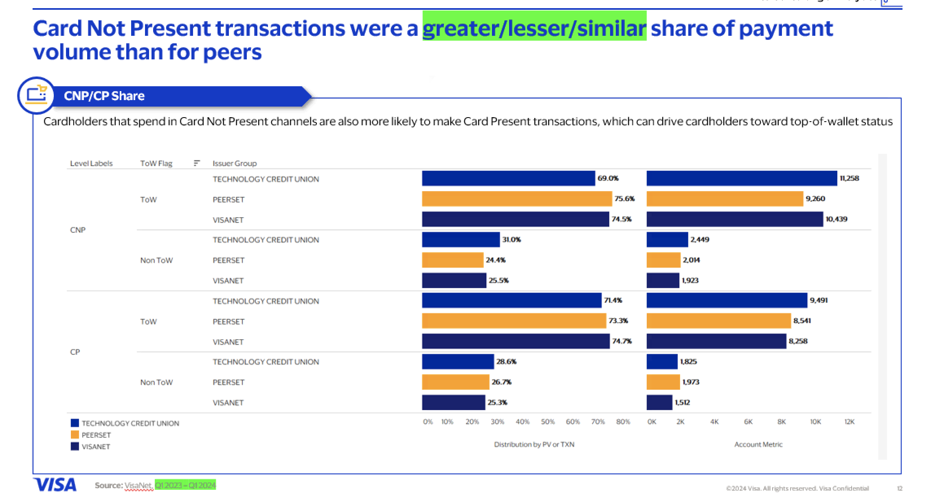
Payment volume growth was similar relative to peers
Source: VisaNet, Q1 2024 - Q2 2024

Slide 14
Payment volume growth was similar relative to peers
Source: VisaNet, Q1 2024 - Q2 2024

